Slide 1
DEF/LEF to SVG
AHMED SHARAF-ELDEIN 900162790
AHMED MARZOUK 900161641
ALAA MOHAMED 900162316
AHMED FAYED 900162747
Repo: https://github.com/AhmedSharaf98/DEF-to-SVG

Slide 2
Problem
- Convert a routed design in DEF and LEF to a layout in SVG.
- Make it web-based.

Slide 3
File Formats
Input files:
DEF file
LEF file
Output file:
SVG file

Slide 4
Libs/tools used
- svgZoomPan https://github.com/ariutta/svg-pan-zoom
- jquery, JavaScript, HTML, CSS
- DEF and LEF parser https://github.com/claude-abounegm/DEF-Viewer/tree/master/DEFViewer/Scripts/Custom
- Bootstrap

Slide 5
Solution
- Parse the DEF and LEF files.
- Iterate through the parsed DEF object and, using SVG library and the parsed LEF, draw:
Every cell given the dimensions stated in the LEF file and the locations stated on the .def file.
The pins.
The nets.
- Meanwhile: prepare the popover data, search data, and record DRC violations.

Slide 6
Code structure
index.js
SVGlib.js
parser.js
drc.js
svgZoomPan.js

Slide 7
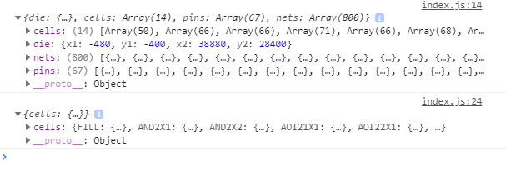
Parsing the DEF and LEF files.

Slide 8
DRC Checking
DRC errors are checked according to the design rules specified by the LEF file
The spacing information is read from the LEF file
The wires and vias are checked iteratively, and the DRC errors are recorded
The recorded DRC errors are drawn

Slide 9
Features

Slide 10
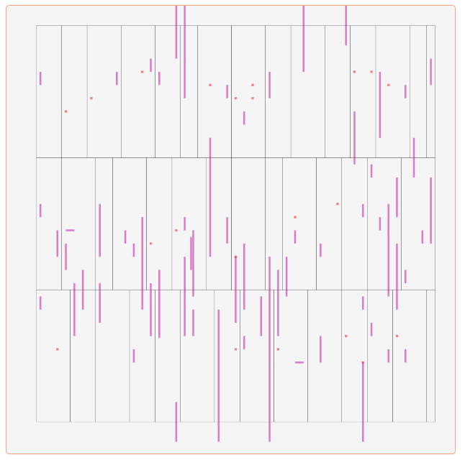
Filter by Type
You can choose one or more filters to filter what content is displayed. Ex. Metal 2 layer is only displayed on the right.

Slide 11
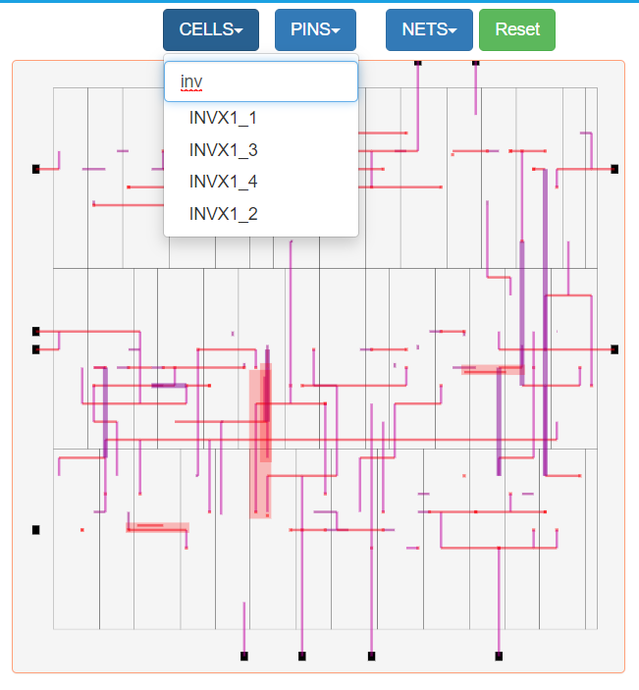
Search By Cell Name, Pin Name, And Net Name
By changing some values manually in the DEF file, we can see that some DRC errors are introduced.

Slide 12
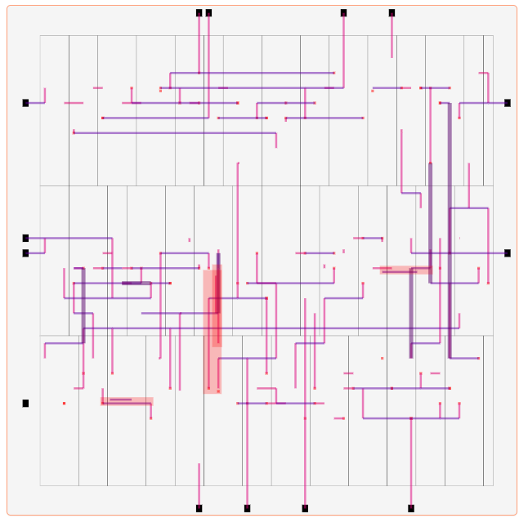
DRC Testing: Introducing errors
By changing some values manually in the DEF file, we can see that some DRC errors are introduced.

Slide 13
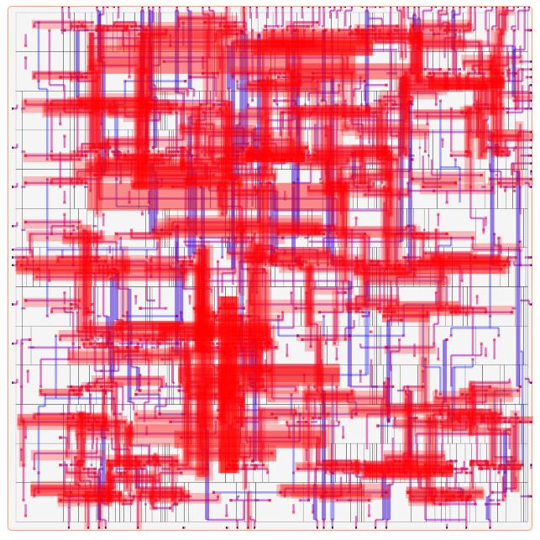
DRC Testing: Changing Design Rules
By changing the pitch value in the LEF file, we can see that many errors are introduced.

Slide 14
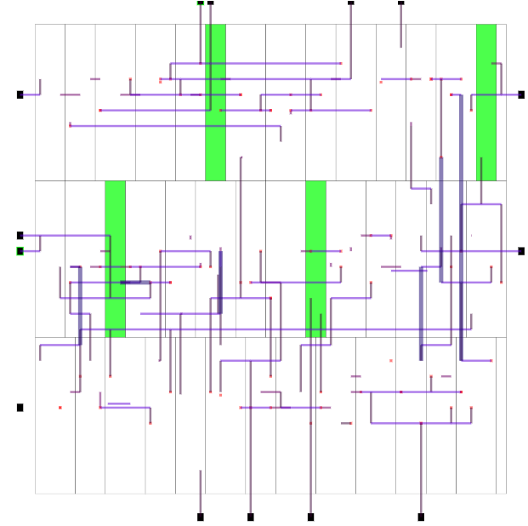
Intermediate State
The functionality of saving an intermediate state after highlighting some components is added.

Slide 15
Limitations
- Some of the features might not be supported on older browsers.
- DRC algorithm might not be 100% accurate.
- DRC algorithm takes relatively long time in large designs, which might affect the user experience.

Slide 16
Future Work
- Ensure the compatibility with all the well-known browsers
- Integrate the tool with an external DRC checking tool
- Handle heavy computations on the server side
- Since the DRC checking is the most computationally expensive procedure, it can be made optional to the user to give an overall better user experience.

Slide 17
How to build the solution
- After downloading the project, just open “index.html” file

Slide 18
LIVE DEMO
https://def2svg.000webhostapp.com/

Slide 19
Future Work
For large files,Make the processing server side instead of client side!

Slide 20
THANK YOU

Slide 21
Who did what?
- Ahmed Sharaf-Eldein
Programing interface for SVG drawing.
Exporting to SVG file format.
SVG layering.
- Alaa Mohamed
Finding DRC errors.
Graphically highlighting DRC errors in the layout.
User Interface Design improvement
- Ahmed Marzouk
Drawing and scaling the layout.
Adding the hover effect.
Adding the search feature.
- Ahmed Fayed
Integrating all the new features together.
Testing Everything.
User interface design.

